Slide 1
ATF ONDOY Clean Up Ops

Slide 2
Background
Small contingents (1-2 jeeps) were sent to clean up during the relief period in the following areas:
Sept 27: Ateneoville, Nangka, Marikina (led by OSCI, ROTC, and joined by Fr. Nebres)
Sept 30: GK Brookside (led by GK-Ateneo)
Oct 3/4: Post-relief operations were finalized.
Oct 5-16: ATF Ondoy clean up operation led by GK-Ateneo team, OSA, ADSA, ADAA, OSCI.

Slide 3
Areas Serviced
Ateneoville, Nangka, Marikina
GK Brookside, Bagong Silangan, Quezon City
GK Camacho, Nangka Marikina
Dela Costa Homes 5, San Mateo, Rizal
Provident Village, Marikina

Slide 4
Partners
Partner | Contribution
ATF Ondoy Donors | Clean up ops fund
DATEM Construction (thru Arch. Bong Recio) | 2 Payloaders
DMCI Construction (thru Arch. Bong Recio) | 2 Payloaders
BIGHOUSE Trucks of Mr. Gibert Leal (thru Jerry Esquivel and Ma’am Temay ) | 3 Dumptrucks
JSA (thru Jun Granada) | Manpower and transportation for mini-payloader
Gawad Kalinga e.V. | P 465,000 donation
BPI Foundation | P 100,000 donation

Slide 5
Participants
500 participants from the following groups:
LS Maintenance
Health Sciences Program
LS Classes
GK Volunteers
Individual sign-ups
Complete list of participants compiled with Office of Admistrative Services c/o Ms. Lucia Chaves.

Slide 6
GK Camacho

Slide 7
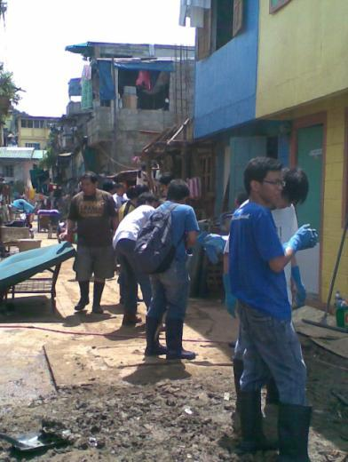
GK Camacho

Slide 8
GK Camacho

Slide 9
GK Camacho

Slide 10
GK Camacho

Slide 11
Dela Costa 5

Slide 12
Dela Costa 5

Slide 13
Dela Costa 5

Slide 14
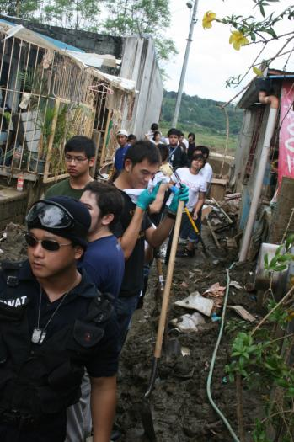
Dela Costa 5

Slide 15
Dela Costa 5

Slide 16
GK Brookside

Slide 17
GK Brookside

Slide 18
GK Brookside

Slide 19
GK Brookside

Slide 20
GK Brookside

Slide 21
Provident

Slide 22
Provident

Slide 23
Provident

Slide 24
Provident (processing)

Slide 25
Provident

Slide 26
ATF ONDOY Clean Up Ops

